Slide 1
Angular Upskilling Program
Component Lifecycle Hooks

Slide 2
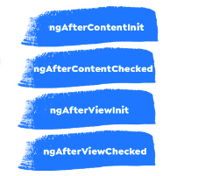
Component’s Lifecycle Hooks
There are a series of 4 methods that are not related to
the component itself but to its children:
- ngAfterContentInit()
ngAfterContentChecked()
ngAfterViewInit()
ngAfterViewChecked()

Slide 3
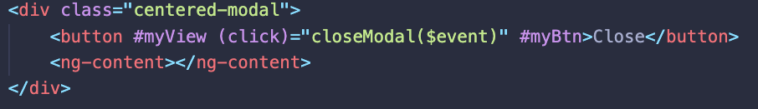
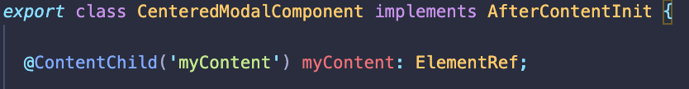
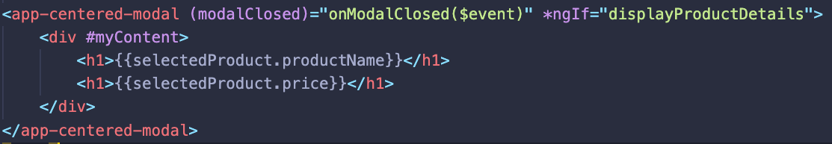
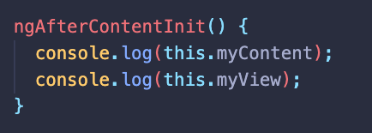
ngAfterContentInit
In order to avoid the mixings of too many @Input properties it is suggested to use content projection. ngAfterContentInit is called when the HTML elements from the <ng-content> container is rendered and ready to be used.

Slide 4
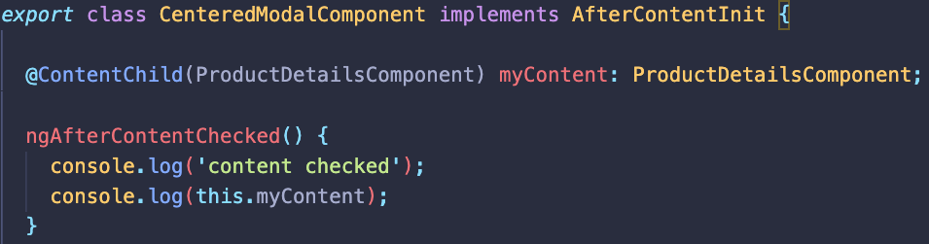
ngAfterContentChecked
Triggered as usual after change detection mechanism has been applied to the content projected component.
Very usefull to check if any changes has been applied to the content projected component if the ChangeDetectionStrategy has been changed to OnPush.

Slide 5
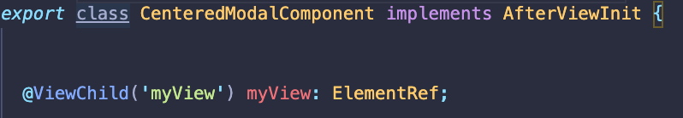
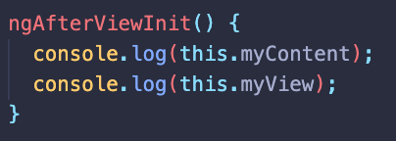
ngAfterViewInit
When using Javascript, the mechanism for getting references to the HTML elements is realized by the help of selectors: classes, identifiers, element types.
In the framework world we are not only using the plain HTML elements but also the Component wrappers. In order to manage the components from their parent, Angular offers us a mechanism to get a refference to children components/elements.

Slide 6
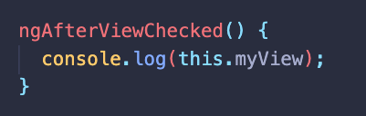
ngAfterViewChecked
Triggered as usual after change detection mechanism has been applied to the child HTML element or component.
Very usefull to check if any changes has been applied to the child component if the ChangeDetectionStrategy has been changed to OnPush.

Slide 7


